Slide 1
Extended Features of ER Diagram
CSE 215 (Database)
Ref: Korth (Chapter 7.8)
Md. Saiful Islam
Lecturer
Department of CSE, BUET

Slide 2
Specialization
An entity set may include sub-groupings of entities that are distinct in some way from other entities in the set.
Let’s say, there can be two types of persons in a university
employee
student
Common attributes: ID, name, and address
Distinct attributes for employee: salary
Distinct attributes for student: total_credits

Slide 3
Specialization
The process of designating subgroupings within an entity set is called specialization.
The specialization of person allows us to distinguish among person entities according to whether they correspond to employees or students: in general, a person could be an employee, a student, both, or neither.

Slide 4
Specialization
As another example, suppose the university divides students into two categories: graduate and undergraduate.
Graduate students have an office assigned to them.
Undergraduate students are assigned to a residential college.
Each of these student types is described by a set of attributes that includes all the attributes of the entity set student plus additional attributes.

Slide 5
Specialization
The university could create two specializations of student, namely graduate and undergraduate.
Student entities are described by the attributes ID, name, address, and tot cred.
The entity set graduate would have all the attributes of student and an additional attribute office number.
The entity set undergraduate would have all the attributes of student, and an additional attribute residential college.

Slide 6
Specialization
Another example: university employees can be classified into two categories
Instructor
Secretary
An entity set may be specialized by more than one distinguishing feature
Employees can be classified based on whether the person is a temporary (limited term) employee or a permanent employee.

Slide 7
Specialization
Specialization is depicted by a hollow arrow-head pointing from the specialized entity to the other entity. We refer to this relationship as the “IS A” relationship, which stands for “is a” and represents, for example, that an instructor “is a” employee.

Slide 8
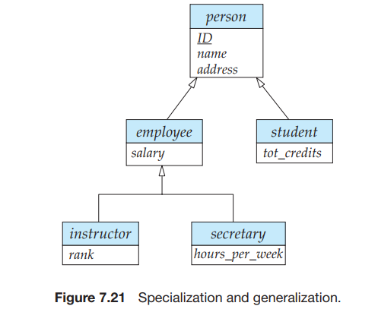
Specialization

Slide 9
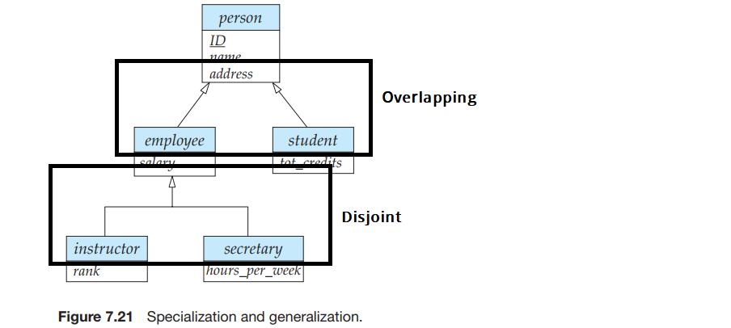
Disjoint vs Overlapping Specialization
An entity may belong to multiple specialized entity sets → overlapping.
An entity may belong to at most one specialized entity sets → disjoint.

Slide 10
Generalization
Generalization is a simple inversion of specialization.
We apply both processes, in combination, in the course of designing the E-R schema for an enterprise.
In terms of the E-R diagram itself, we do not distinguish between specialization and generalization.

Slide 11
Completeness of Generalization
Total generalization or specialization Each higher-level entity must belong to a lower-level entity set.
Partial generalization or specialization
Some higher-level entities may not belong to any lower-level entity set.

Slide 12
Completeness of Generalization
Partial generalization is the default. We can specify total generalization in an E-R diagram by adding the keyword “total” in the diagram and drawing a dashed line from the keyword to the corresponding hollow arrow-head to which it applies (for a total generalization), or to the set of hollow arrow-heads to which it applies (for an overlapping generalization).

Slide 13
Attribute Inheritance
The attributes of the higher-level entity sets are said to be inherited by the lower-level entity sets.
student and employee inherit the attributes of person.

Slide 14
Attribute Inheritance
A lower-level entity set (or subclass) also inherits participation in the relationship sets in which its higher-level entity (or superclass) participates.
suppose the person entity set participates in a relationship person-dept with department. Then, the student, employee, instructor and secretary entity sets, which are subclasses of the person entity set, also implicitly participate in the person-dept relationship with department.

Slide 15
Aggregation
Consider the scenario where each instructor guiding a student on a project is required to file a monthly evaluation report. We model the evaluation report as an entity evaluation, with a primary key evaluation id.

Slide 16
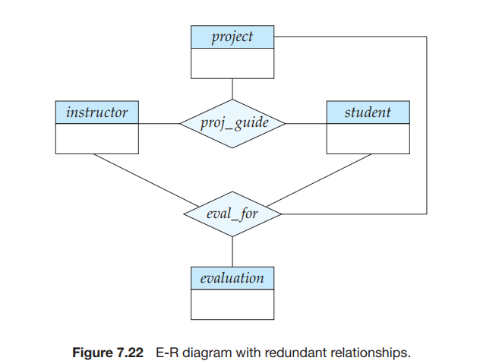
Aggregation

Slide 17
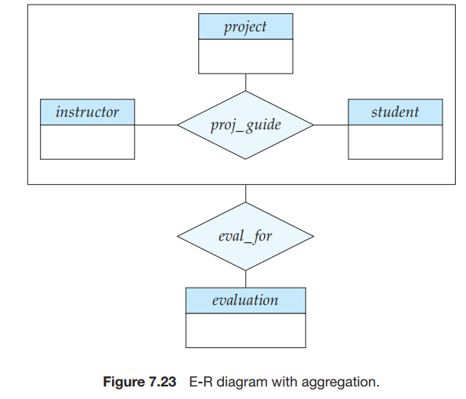
Aggregation

